Slide 1
Cloud-based Recommendation Based on Personality Identification
Ammar Khan 17010020010
Mohammad Zafar Haider Butt 160090065003 Supervisor: Miss Shakra

Slide 2
Introduction
In the age of Big Data and Cloud-Computing, where the user base is keep growing and the classifiers to make the algorithms better are becoming more diverse than ever.
User-based and item-based algorithms lacked item-similarity and scalability issues and the other lacked diversity issues.
This study focuses on developing a modern day well-clustered hybrid recommendation system that involves machine learning, cloud-computing and psychological researches to provide scalable and personalized recommendation system to address the need to tailor content within the brackets of identified groups.

Slide 3
problem Overview
The algorithms that are available in the market or proposed in research papers addresses similarities between items very well. The user-user are solely mapped based on their interaction with the items.
The cold start problem has been solved up to an extent, but still in question, because the recommender systems are not aware of the user-user similarity
Second problem is the clustering of the data.
None of the recommendation system incorporates any methodology to identify trends of impulsive buying.
Ancient Toolchains for ML, except the big 3 companies.

Slide 4
Research Question
To devise a system that can form user-item sub-matrices to introduce clustering .
Users will be classified based on Big Five personality traits and will be put into separate clusters based on these classifiers.
The system is then expected to draw recommendations based on nearest neighbors from within their category.
Keeping personalized recommendations within diversity group.

Slide 5
Research Objectives
Collecting psychometric data to populate Big Five model classifiers.
Breakdown of user-item matrix based on classifiers from personality model using K-Means Clustering.
Hybrid User-Item Collaborative filtering recommendation system
Upgrading the underlying tool chain to latest technologies to eliminate software/hardware restrictions.

Slide 6
Background
Research in Psychology provides us with empirical evidence to trace distinct patterns across psychometric scores
Which scale to use?
Johnson IPIP-120 provides an effective way to scale number of questions down to 120 from original 300 scale
Provides great insights on a person’s personality, mental health, collaborative task performance, personnel hiring etc.
Predictions about Five Factors deduced from Big 5 model and time decay.

Slide 7
Literature review
Research Papers:
Amazon.com Recommendations: Item-to-Item Collaborative Filtering.
Hybrid User-Item Based Collaborative Filtering(CBR Avg Filtering and SOM with GA to classify users)
Does Personality Affect Compulsive Buying? An Application of the Big Five Personality Model
TwitPersonality: Computing Personality Traits from Tweets using Word embeddings and Supervised Learning
Netflix Prize, a user-item recommendation system using SVD

Slide 8
Proposed system
A cloud-based ML unsupervised hybrid user-item collaborative filtering model that will be encapsulated within three layers.
Hybrid Content-Based CF algorithm will plot user-rating matrix.
Each cluster will be formed using X-means.
Each cluster shall reflect the pattern described work flow hypotheses
The system will be built on NoSQL solutions to facilitate horizontal scaling.
Apache Spark for In-Memory Clustered Item-based CF.

Slide 9
Suggested Approach
Netflix Prize and several other algorithms provide great insight into problem statement.
But, using averaging and error function directly on user ratings without a distinct pattern can cause over predicting and under predicating.
With Big five, we can apply specific corrections for each personality type.
Time decay can be differently assigned to user clusters, which was not possible to apply on users in previous systems.

Slide 10
Work Flow
A corelated data of user personality type is required and how it maps on the movie selection.
Hypothesis on patterns:
Users with higher score in Openness should be interested in broader set of genres.
Users with higher score in Conscientiousness should have a structured pattern of genre selection with near to constant time decay.
Users with higher score in Extraversion should have lower value of time decay.
Users with higher score in Agreeableness should have movies ranking higher than average users.
Users with higher score in Neuroticism should have flexible time decay.
Big 5 traits should work in conjunction, as it is already being researched in the field of Psychology.
Machine Learning model should be able to map content based on range defined by Big 5 scores.

Slide 11
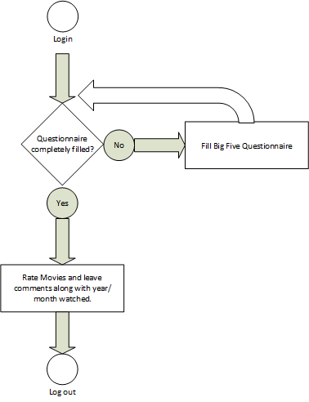
User Work Flow Diagram

Slide 12
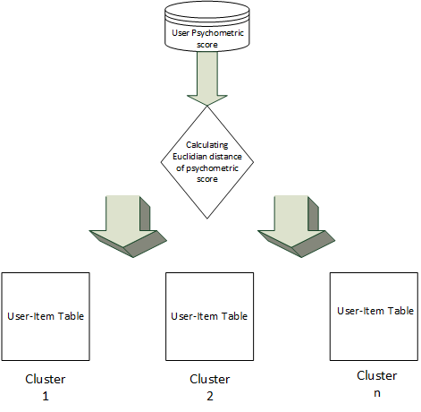
ML Model training diagram

Slide 13
System Components
AWS S3
AWS CloudFront (FLASK RESTFUL API)
AWS API Gateway
AWS Cognito
AWS DynamoDB
AWS Lambda
AWS SageMaker

Slide 14
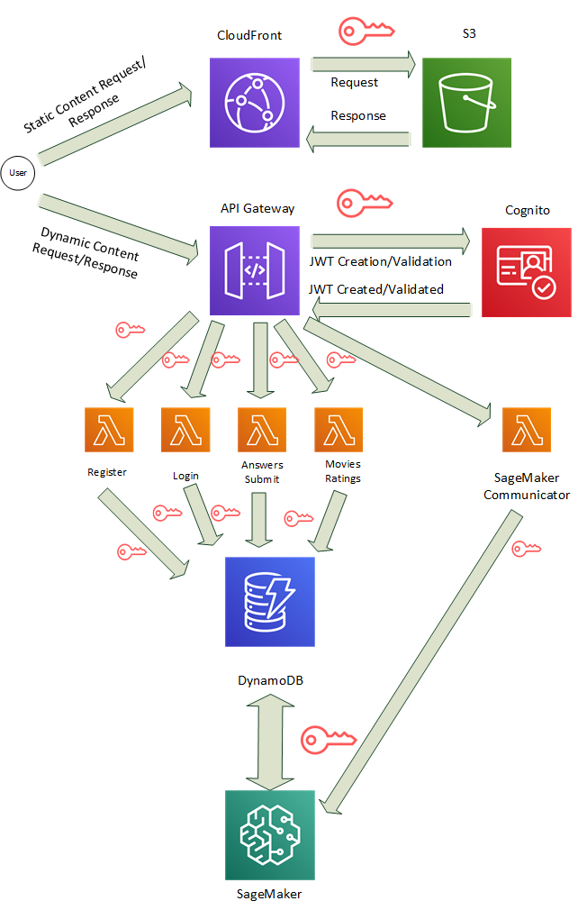
System Architecture

Slide 15
DynamoDB Database design

Slide 16
System Interface and Implementation
The system designed employs serverless model.
Interface is kept minimal for ease of use by the user.
Pages have API routes associated with it upon which they act upon.
JS is used to make pages dynamic by calling API Gateway.

Slide 17
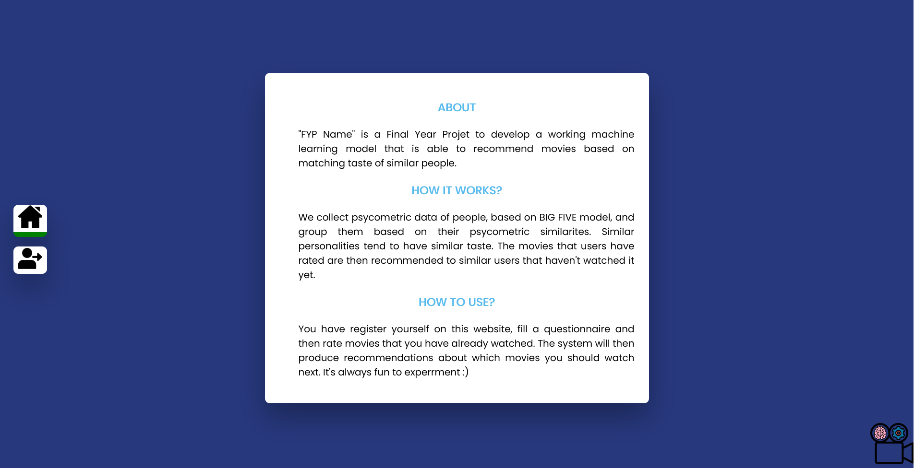
Index Page

Slide 18
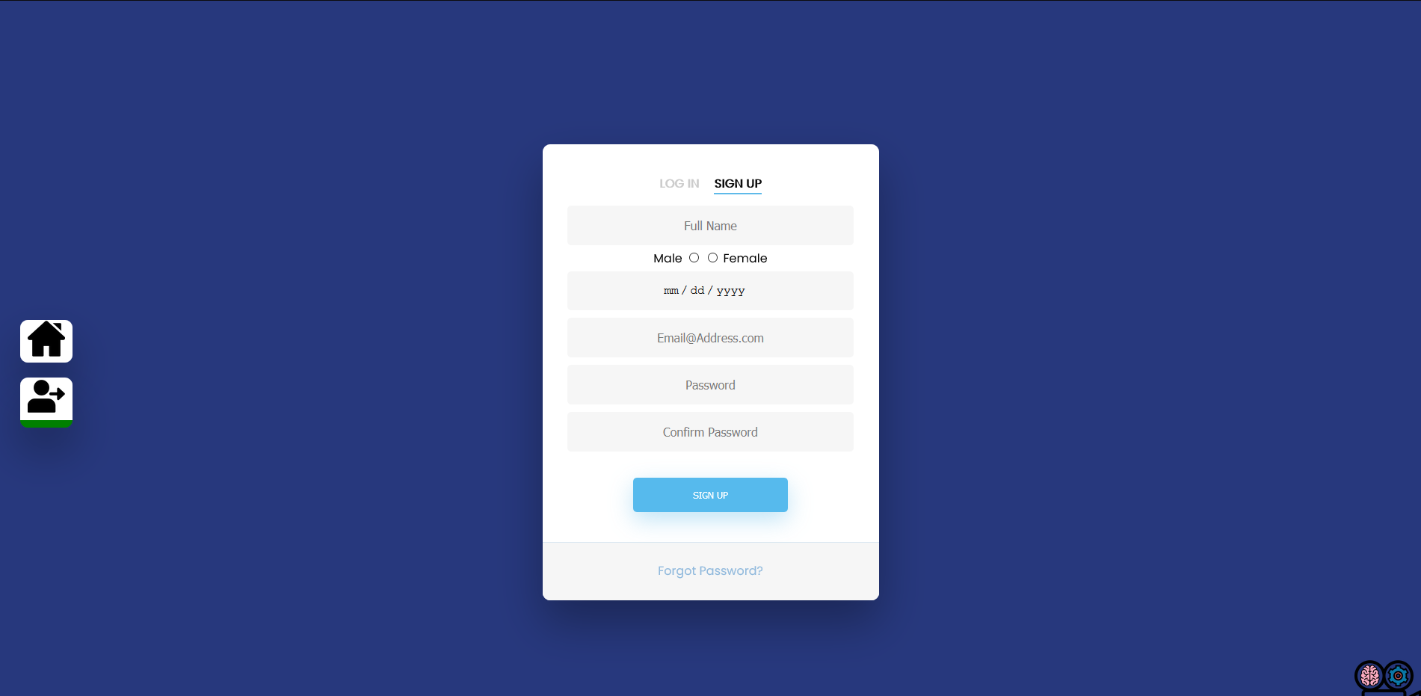
Signup Page

Slide 19
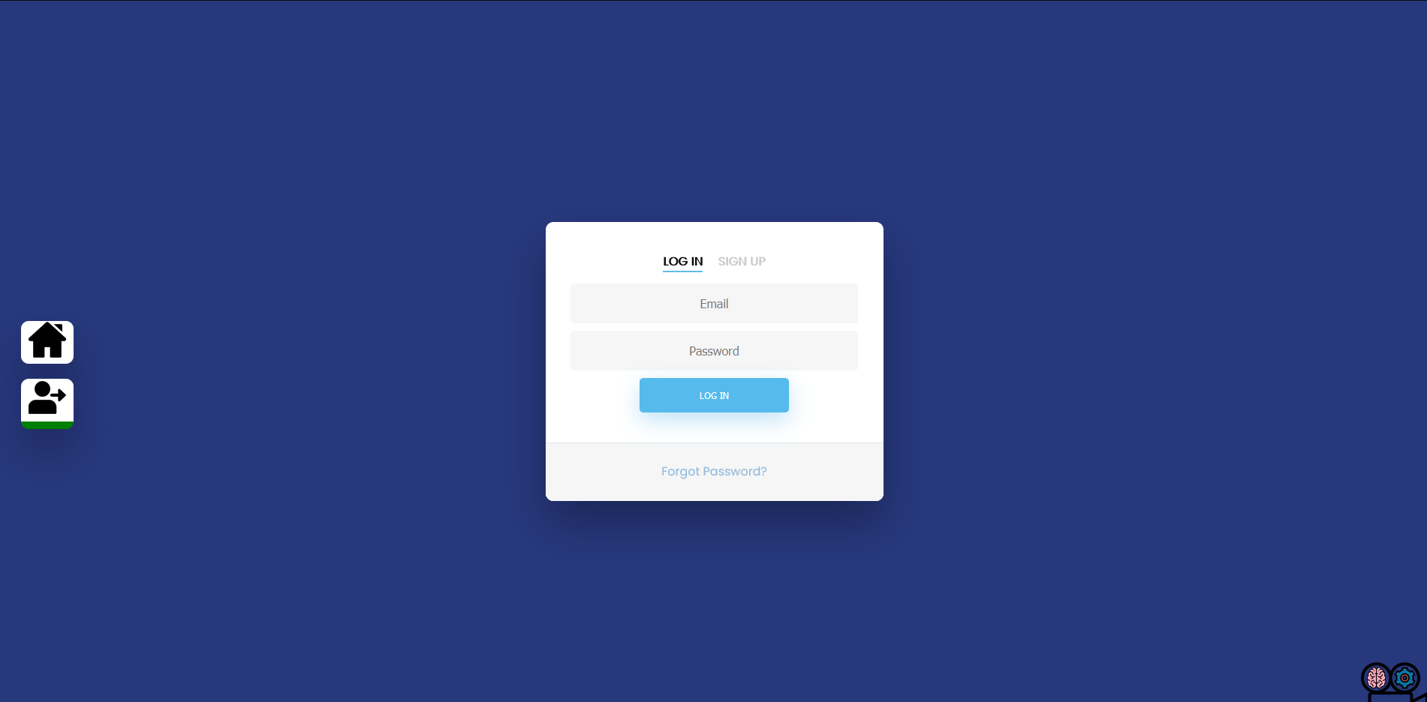
Login Page

Slide 20
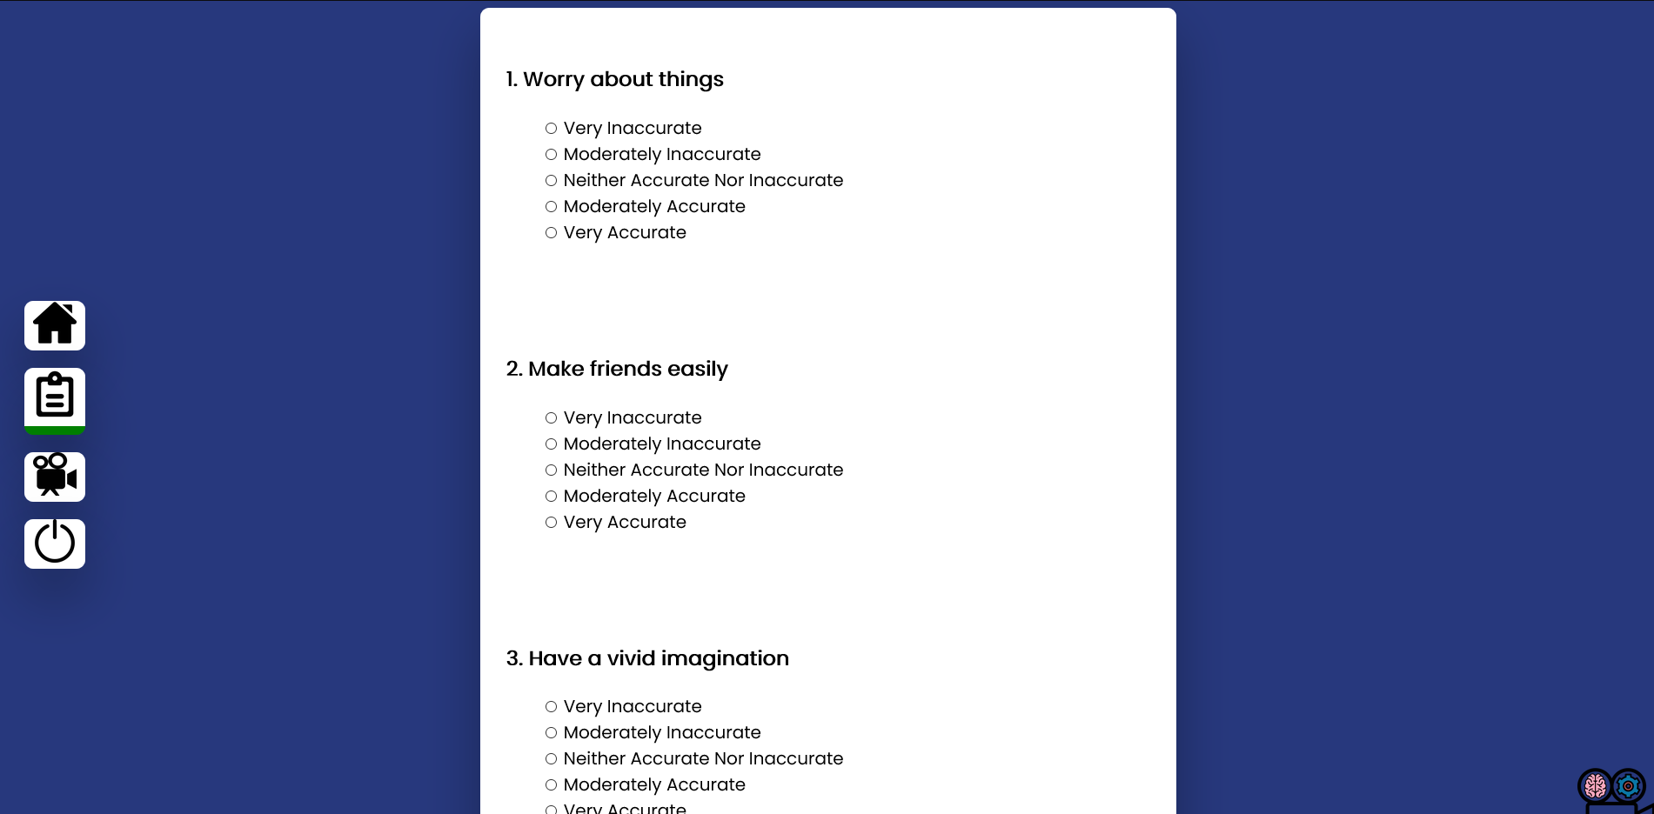
Questionnaire Page

Slide 21
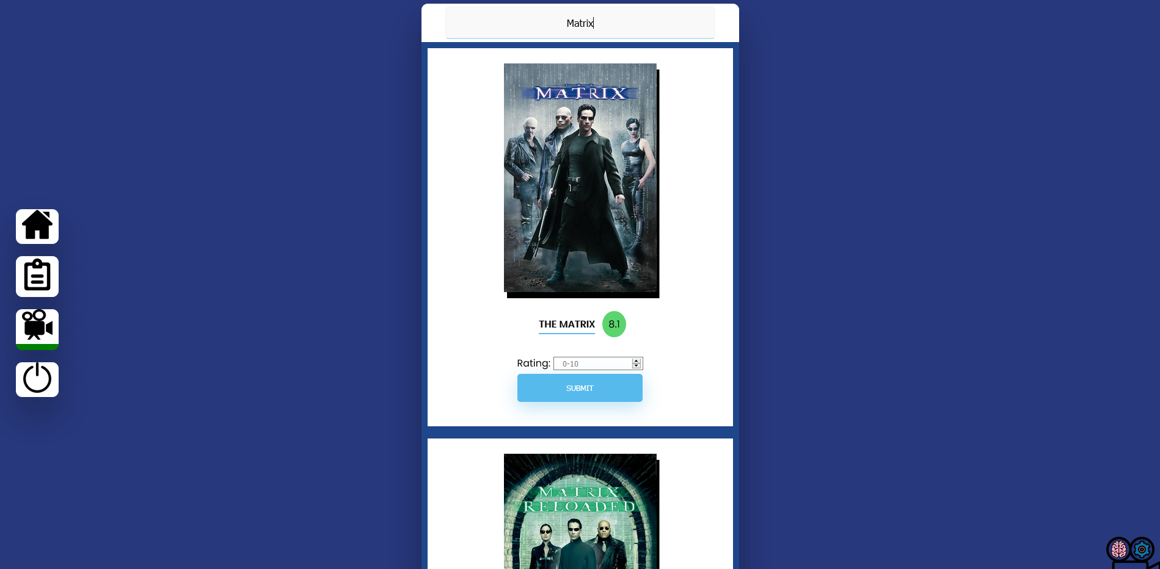
Movie Search Page

Slide 22
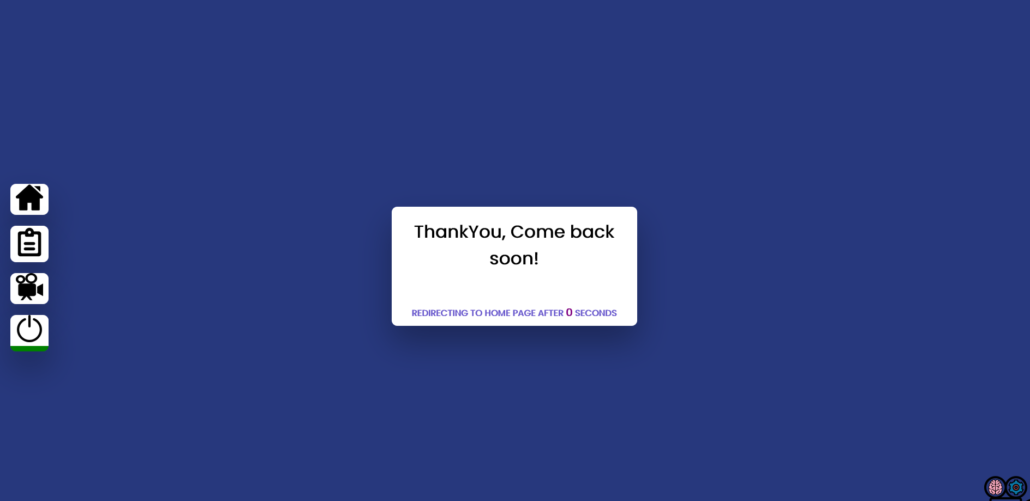
Logout
Page

Slide 23
Assumption and Constraints
When the first run is over, i.e., we have collected dataset for our ML model training, we then would be able to begin OLAP transitions and apply ML algorithms using psychometrics to create clusters.
Once the clusters are formed and are plotted with user-item entries, we can then look for the patterns of hypothesis described in the documents.
After that, SageMaker trained model will be deployed and will be able to generate sound recommendations.

Slide 24
Experimental Setup
A web portal with serverless design to increase the reach to target audience and still be cost-effective.
User required procedures: Signup -> Login -> Fill Questionnaire -> Rate Movies.
Model training via SageMaker via X-Means algorithm.
Deployed model will provide recommendations on the protal.

Slide 25
Experiment Design/Details
Its all about getting required items for clustering without annoying the users and providing quality recommendations in return.
Signup Procedure: Gets required details about users like gender and birthdate along with authentication/authorization data.
Questionnaire: 120 statements. 24 statements per trait. No consecutive occurrences for a single trait question and some trait questions have reverse polarity in order to eliminate bias.

Slide 26
Continue…
Movie Review: A search bar connected to TMDB API. Designed in a way to facilitate users to view single results more prominently and if there are sequels for a movie, they can be rated in one search hit.
Recommendation System Logic: Design for database provides easy access for both OLTP and OLAP. Training model can fetch full results for all users via primary key. Once, the model is trained, new users and new reviews can be pulled via primary key and sort key “date format”. Transactions can be processed with primary key and sort key “metadata”.

Slide 27
Continue…
Trained Model: Once trained, the model will be attached to the portal via JS Ajax procedure to fetch results from API endpoint that is linked with SageMaker. Users will be asked to rate the quality of recommendations to validate our experiment.

Slide 28
REFERNCES
https://dl.acm.org/doi/10.1145/371920.372071
https://www.researchgate.net/publication/282831954_Hybrid_User-Item_Based_Collaborative_Filtering
https://www.researchgate.net/publication/236343567_Does_Personality_Affect_Compulsive_Buying_An_Application_of_the_Big_Five_Personality_Model
https://www.researchgate.net/publication/325398350_Effects_of_Personality_on_Impulsive_Buying_Behavior_Evidence_from_a_Developing_Country
https://www.researchgate.net/publication/325263677_TwitPersonality_Computing_Personality_Traits_from_Tweets_Using_Word_Embeddings_and_Supervised_Learning
https://ieeexplore.ieee.org/document/1167344
https://ieeexplore.ieee.org/document/7558226
https://www.sciencedirect.com/science/article/abs/pii/S0969698915300564

